Slide 1
High Quality Assessments:
Developing Global Citizens Through WorkKeys

Slide 2
Partnership with ACT and Collective offerings
Current socio – economic conditions in India
Our solutions
Notes:
Milind CEO Bellcurve labs and I am here to talk about out partnership with ACT and current offering from ACT + BellCUrve Labs to Indian Market
We are also going to talk about social and economic conditions in India in order to demonstarte the needs in India
Finally we will propose our solutions – a comprehensive approach to bridge gaps between current conditions and ideal – In India full employment prosperity and growth
Background about ACT

Slide 3

Behind everything we do at ACT is a passion for making things better. In fact, that’s how ACT started.
In 1959, University of Iowa education professor E.F. Lindquist launched the forerunner to the ACT® assessment, now known as the ACT college readiness assessment.
Notes:
Little background about ACT

Slide 4
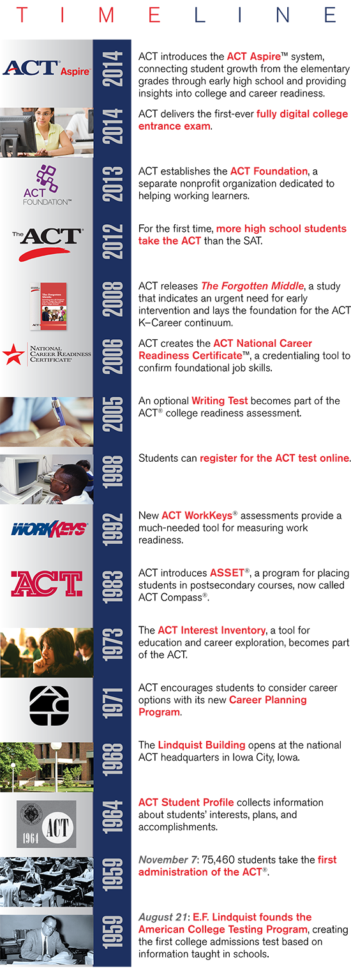
TIMELINE

Slide 5
TIMELINE

Slide 6
TIMELINE

Slide 7

What ACT does?
Each year, our nonprofit organization reaches millions of people in all 50 states and in more than 130 countries worldwide. Our research and assessments yield vital insights about college and career readiness.

Slide 8


ACT—Key Areas of Focus
K-12 Educational assessment
Postsecondary Educational placement and enrollment assessment
Workforce development
We are the USA leader in college and career readiness, providing research-based solutions grounded in more than 50 years of experience.
6

Slide 9
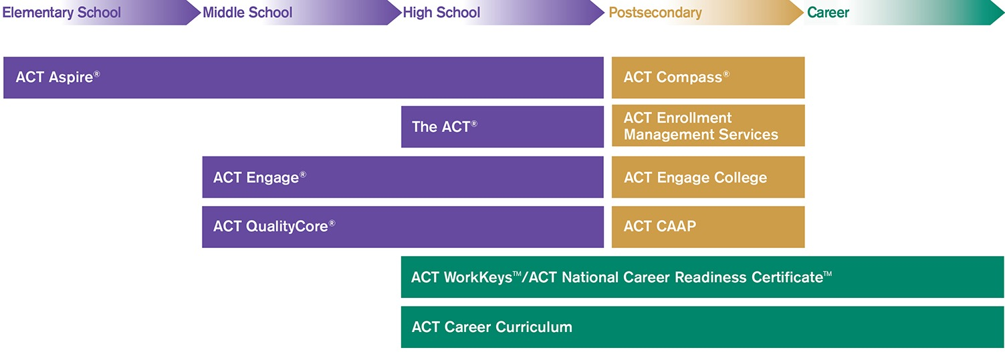
ACT Continuum—K through Career
ACT Engage™
Grades 0-12
8
Notes:
This is complete suite of tools ACT offers for students from Emenetry, Middle, High School, Post Secondary and Career
This is an ilustration of how comprehensive ACT’s education offerings
Programs begin from Elementry, Middle , High schools and Career , these are examples of proven established programs that succeed

Slide 10
K12 – Educational Assessment
ACT = most widely used college admission exam in the world
1,8M (57%) = students take ACT exam in US
100% = number of US colleges / Universities accept ACT results
225= Colleges outside of US also accept ACT results
Growing tendency in US students to take both tests ACT and SAT
ACT is only test which measures Content knowledge in Science
ACT Engage™
Grades 0-12
8
Notes:
For the purpose of today’s discussion time doesn’e permit to go in discussion for elementry / middle program, instead lets begin with ACT Exams

Slide 11
K12 – educational Assessment – Prep Tools
Pre-ACT Exam
                Assess readiness for the formal examination
                Identify Strength and Weakness
ACT Online Prep
                Provide guided practice in improving weakness and enhance
                strengths
ACT Engage™
Grades 0-12
                Results into
                Higher Test Scores,
                Better College Placement
                Securing Scholarships
8

Slide 12

WorkForce Development
9
Notes:
Most of us are familiar with ACT exam and related prep tools
Now we would like to bring another suite of tools used for Workforece development across the world – WorkKeys and KeyTrain
Let’s go in more detail

Slide 13



WorkKeys assessments help employers select, hire, train, develop, and retain a high-performance workforce.
Interactive Training to Improve Workplace Skills
Self-paced course modules
Delivered online
24/7/365 access
Notes:
ACT WorkKeys full assess essential workplace skills and ACT Keytrain provides online 24x7 training to develop these essential skills and demonstrate mastery through Globally recognized certiciatificition process
More than 400 PHD’s do Full TIME continuous research and evaluation of new and existing job profiles.
They are ACT’s most valuable asset.
ACT

Slide 14
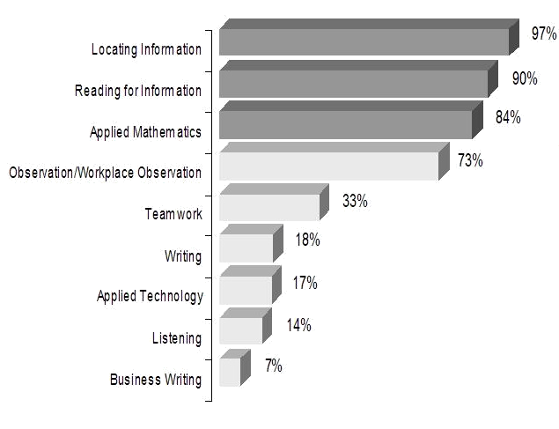
How does it work?
There are 9 Cognitive Skills to the CRC Assessments
}
  77% of all profiled occupations require ALL of these skills.
Notes:
These top skills represents bulk of the skills required to be successful in your work place at all levels. This assessment has been backed by more than 50 years of data gathering and more than 400 PHD’s defining Job profiles and analyzing the data

Slide 15
3 Skills are Assessed by WorkKeys Non-Cognitive Assessments (Behavioral)
Talent
Performance
Fit

Slide 16





Reading for
Information
Locating
Information
Applied
Math
6
6
6
5
5
5
4
4
4
3
3
3
Source: ACT jobs Data 2006-2010
Notes:
In US there

Slide 17


Opportunities in Today's Changing Indian Education / Career Markets
India has the world’s largest workforce, 500 million+ (Minister of Labor)
By 2020 is will surpass 900 million (Ernest & Young)
Only 2% of India’s workforce considered “skilled” (India Labor Report 2014)
30 million individuals added to workforce yearly (India Labor Bureau)
India’s entire internal capacity to train 3.1 million OVER NEXT 10 YEARS!
400 million = number of new jobs targeted by PM Modi by 2020

Slide 18


WORKKEYS is For Whom?
EDUCATION
CORPORATE
GOVERMENT

Slide 19



EDUCATION
High Schools
University
MBA
Certifying to Work Readiness
EX:
7 states in the US do it to every student
Getting ahead of the competition
EX:
Taylor University - Malasia
Getting ahead of the competition
EX:
Taylor University - Malasia

Slide 20

CORPORATE
Hiring
Training /Corporate later
Downsizing
Certifying to Work Readiness
Saving Money
ROI
EX:
8300 companies in the US
Lawn Suite Protection
Non-Discriminating Evaluation
EX:
American Express
Horizontal Promotion / Movement
Certification and Evaluation of everyone
EX International:
Dow Chemical

Slide 21
GOVERMENT
Honduras
Mexico
Canada
Saudi Arabia
Bahamas
Philippines
Certifying to Work Readiness
JOB PROFILING
Certifying Teachers
Federal Mandate for Training and Evaluation

Slide 22
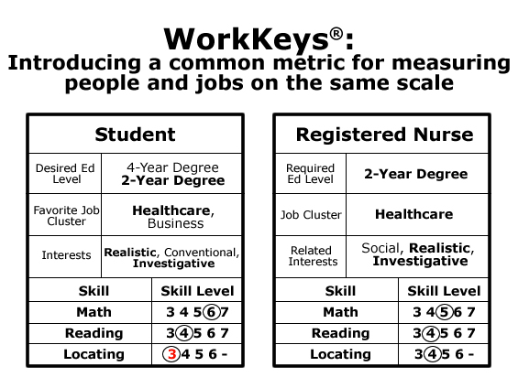
More than 2.3 million NCRCs issued since introduction of NCRC in 2006.
More than 12 million WorkKeys assessments administered in the five-year period between September 2008 and August 2013.
7 US states administer WorkKeys assessments to all High School juniors or seniors.

Slide 23












Just a FEW of our more than 10000 ENDORSERS

Slide 24
ACT
Opportunities Moving Forward?
Notes:
We offer the most powerful and most broadly demonstrated workforce skill development platform in the world. It is proven over 50 years to be best fit in America, we believe it is the best fit to India.

Slide 25
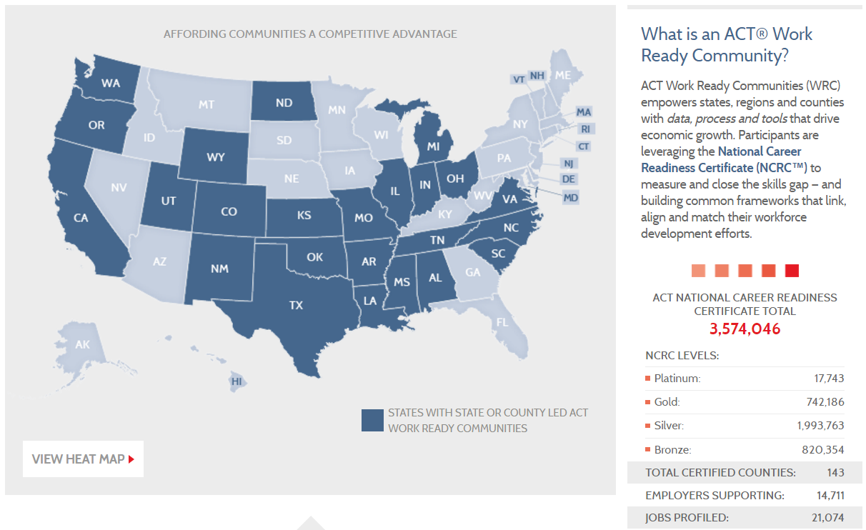

Slide 26

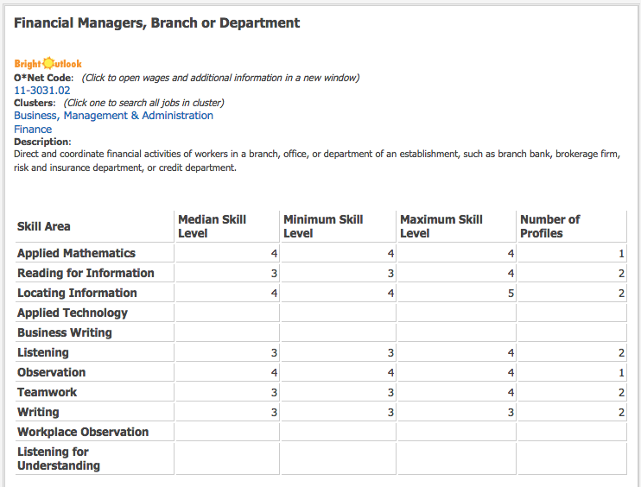



Example 1 of the 21.074 Job Profiles

Slide 27
Step 1: Define the needed skills and create job profiles.
6
5
5
4
4
4
3
3
3
3
3
2
2
2
2
2
1
1
1
1
1
Applied
Math
Locating
Information
Writing
Teamwork
Reading for
Information

Slide 28
Step 2: Job seekers take assessments to identify existing skill levels; employers recruit job candidates based on the assessment results.
6
6
5
5
5
4
4
4
4
4
4
3
3
3
3
>3
2
>3
2
2
Employee Skill Levels
Technician II
5
5
5
4
4
4
4
4
4
4
4
4
4
3
3
3
3
3
2
>3
2
2
>3
2
>3
Technician I
Tech Assistant

