Slide 1

EU Conference - Dublin
James Darley,
Director of Graduate Recruitment

Slide 2


Slide 3
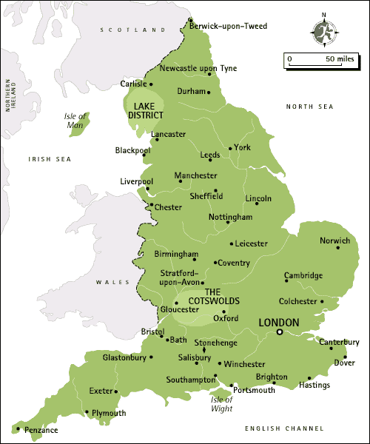
Since placing our first cohort in London in 2003, we have recruited nearly 8,700 teachers and now partner with schools serving low-income communities in every region of England and Wales.
These teachers have now taught more than
1 million pupils across the breadth of
England and Wales.
Growing to 2,000 participants a year would represent
unprecedented growth and would see Teach First:
provide 38% of all new teachers in eligible secondary schools
provide 54% of all new maths and science teachers
in eligible English secondary schools
provide 16% of all new teachers in eligible English
primary schools

Slide 4






Our Impact
Over the past decade we have been working hard to ensure that no child’s educational success is limited by their socio-economic background. There is more to do but we’ve contributed towards significant progress:
Independent Research shows our teachers
are increasing the GCSE results of pupils in low-
income communities across the UK
Schools in London, where we’ve placed 3000
teachers since 2003, have moved from being the
lowest performing in England, to the highest performing
Eighty percent of young people on our Futures
programme progress to Higher Education – compared
to just 17% of students from low-income backgrounds
Our training was graded Outstanding in every
one of the 44 categories assessed in our last
Ofsted inspection.
Teaching in low-income communities is now
the 4th most prestigious career choice for the
country’s top graduates
Our ambassadors are leading change in and
out of the classroom. This community includes
14 headteachers and 38 social enterprises.

Slide 5
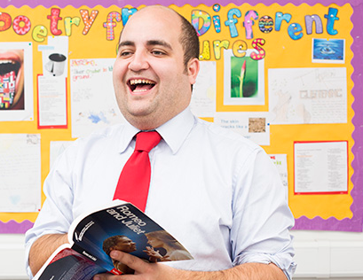
A brief history
of Graduate Recruitment and our successes

Slide 6
Growth of Teach First participant numbers 2003-2014
Growth (‘12-’14)
43%
Growth (‘07-’12)
267%
Growth (‘03-’07)
46%

Slide 7

Our teachers reflect the communities
they serve
We attract and select a more diverse intake than the overall teaching workforce.

Slide 8
Achievements
Largest Graduate Recruiter in the UK – 1,685 hired in 2015
Undergraduate Opportunities – Insight, Societies, Tasters & Brand Managers
Bursaries with 9 Universities – up to £1,000 when joining Teach First
68 Best practice award nominations in Graduate Recruitment (18 wins ☺)
Market share – 6% of all Russell Group graduates apply to Teach First
Number of Oxbridge graduates teaching in a challenging school risen from 6 in 2002 to 130 in 2015 (& 10% of Oxbridge graduates apply to Teach First)

Slide 9










Graduate Recruitment Platinum Partners
Strategic Partnerships that have supported our growth over the past twelve years

Slide 10




The Graduate
Market in 2015

Slide 11
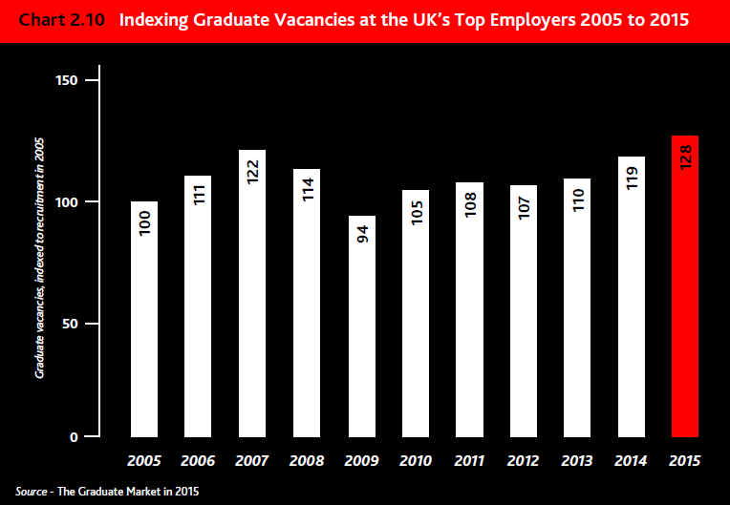
2015 Graduate Marketplace
More jobs
Better paid
Higher debt
Relevant work experience
Job searching earlier
Confident
Motivated
Organised
Accepting multiple offers
Acceptance rate 55%
(last year 80%)

Slide 12
Graduate Market in 2015
Russell Group avoided recent blip in reduction of student numbers
  Graduates leaving UK universities up 85,000 since 2007 to record 365,000
High Fliers
  Teaching out of top 3 of “Total number of finalists interested in sectors”
  Applications to Teaching down 3%
  Average of 39 applications for every job
Graduate starting salaries now at £30,000 (risen after a 4 year freeze)
Four-fifths of UK’s leading graduate employers are offering paid work experience
Over a third of TT100 jobs went to students who had done an internship with that employer

Slide 13

Building a brand on campus

Slide 14
How did Teach First establish itself as a dominant player in the UK graduate market in only 12 years?

Slide 15
How did we do it?
Strategy
  Sell the problem not the profession
  Focus on small number of top universities at the start
  Deliver ‘world-class’ graduate recruitment
  Invest in building relationships with key stakeholders
Brand
  Need to be comparable and then more attractive than other top employment brands
  Highest quality marketing, materials and activity
  Position mutual benefit of the programme (do it for the kids/do it for you)
  Build profile and appeal
Process
  Human recruitment, investing in a team of experts (not superficial high visibility events)
  Effective & efficient attraction & selection
  Early ID & Undergraduate Programmes (Brand managers, Insight & Societies)
Research
  Know your market and competition as well, if not better than everyone else
  Deliver sophisticated objectives and metrics to spot issues early

Slide 16
Importance of metrics and monitoring
Putting evidence at the centre of your decision-making
Using evidence to set the right targets for the future
Supporting with stakeholder management
+
Ensure that you are seeing the big trends through the small ones
Use intelligence to gain an advantage over your competitors
Empower your front-line recruiters

Slide 17



Setting up for intelligent recruitment…
Collect your data…
…make sense of it…
…build your reporting and decision-making around key-data.

Slide 18
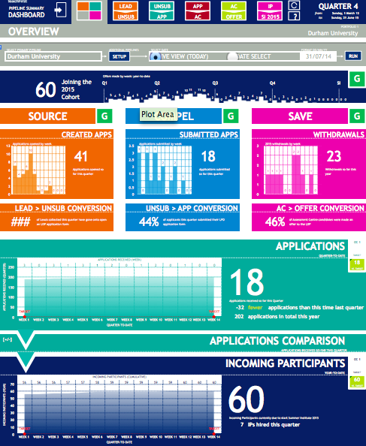
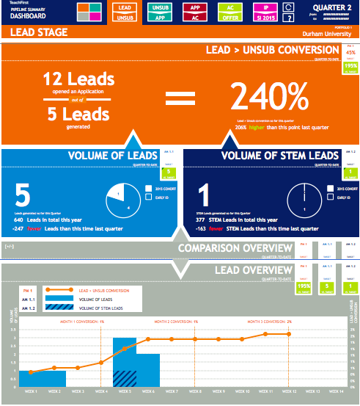
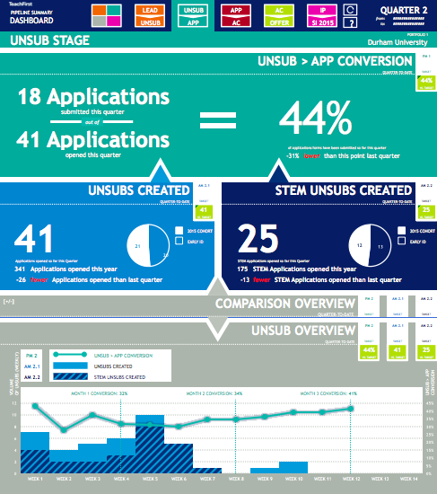
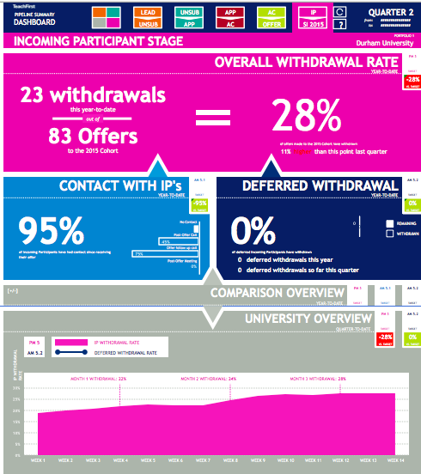
Delivering ‘intelligent’ recruitment…
Data is readily available through reports at all levels of the team
+
Systems and processes within the team will support decision-making
Individual Recruiters
Lead stage
Applicants
Offers
Notes:
Important to stress here that of course not everyone will be able to build tools as big or whizzy as this… but as a principle, what we should all be working towards, is allowing recruiters to have access to information fast, without the need for them to be data-wizards themselves, and it should be being used to help make better decisions.

Slide 19
Delivering ‘intelligent’ recruitment…
Data is readily available through reports at all levels of the team
+
Systems and processes within the team will support decision-making
Individual Recruiters
Conversion insights – in this example, number of submitted applicants out of opened application forms
Drill down – how many STEM applicants are available, and how many can start the Programme this year?
Target data – current performance versus target performance
Trend data – what is the performance story over time?
Notes:
Just more detail on a typical dashboard page

Slide 20
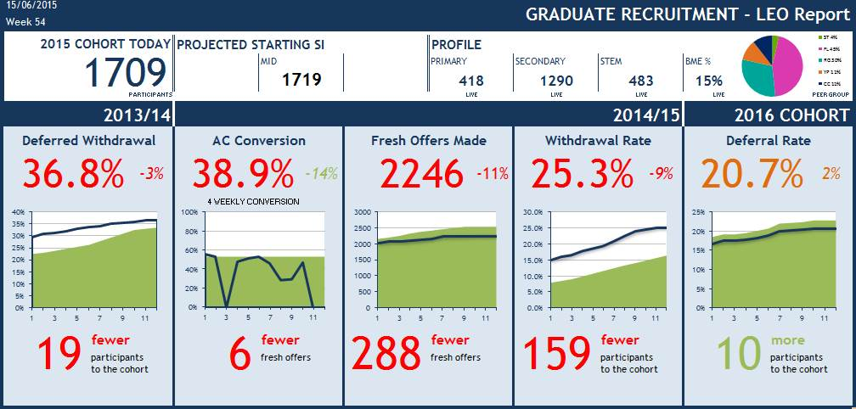
Delivering ‘intelligent’ recruitment…
Data is readily available through reports at all levels of the team
+
Systems and processes within the team will support decision-making
Senior Management
Notes:
Talk around this image – explaining the functions of each part of the dashboard.

Slide 21


Power of the Brand
Your Brand is everything
A strong brand is invaluable as the battle for customers intensifies day by day
An offer from Teach First must be equal or greater than all other aspirational employment brands
Brand Awareness =
Applications =
Hires
Notes:
BW

Slide 22
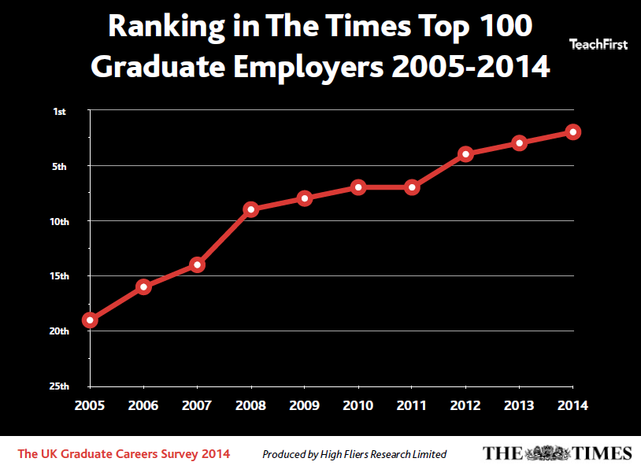
Times Top 100 Graduate Employer ranking – Teach First
In 2003, Teach First entered the UK Times Top 100 Graduate
Employers at 62.
In 2015, 12 years later, teaching in low-income communities is
the 4th most prestigious career
choice for new graduates.

Slide 23
Despite most competitive marketplace to date:
Profile increased in 2015 from 6th to 4th against the Top 100 Graduate Employers
Appeal increased from 4th to 3rd against the Top 100 Graduate Employers

Slide 24
Current Practice
Teach First Graduate Recruitment Model – Long term relationship building:
  Research Industry (High Fliers, Student Board, RGCC), University & Internal
  Intelligence Starter Kits / Industry / Competition
  Marketing Collateral – Brochures / Posters / Flyers / Freebies / Stands
  Advertising Spray & Pray (National / Local) & Targeted (Campus / Course)
  Digital Website / Suppliers / Video / Facebook / Twitter
  Brand Mgr Networked / Empowered / Supported / Trained
  Campus Traditional – Presentations / Careers Fairs / Skills Sessions / Drop-Ins
  Non Traditional – Campus time / HEAPS / Bursaries / Societies

Slide 25

Delivering effective and efficient selection

Slide 26
Selection Overview
Rigorous recruitment and selection process:
Evidence of strong academic qualifications
Demonstrate key competencies and fit with the Teach First vision:
  Humility, Respect and Empathy
  Interaction
  Knowledge (incl. mission)
  Leadership
  Planning and Organising
  Problem Solving
  Resilience
  Self-Evaluation
Pass professional skills tests in numeracy and literacy
Pass subject knowledge audit
School Observation week
Complete Summer Institute & PGCE in line with the Teach First values:
COMMITMENT COLLABORATION EXCELLENCE INTEGRITY LEADERSHIP
Notes:
Interaction is similar to Influencing & Motivating
Resilience is similar to Perseverance

Slide 27
Selection Overview
Application Form:
Screened independently by two members of the team
Holistic approach taken:
  Academics (ITT & Teach First)
  Positions of Responsibility
  Competency questions
Assessors trained and continually checked for consistency
Evidence/marking sheets used - decision made (no automatic cut off)
Conflict requires conversation to discuss evidence
Successful applications move on to Assessment Centre

Slide 28
Selection Overview
Assessment Centre:
Competency Based Interview:
  Personal history, work experience, attitudes to working with children
  Teach First competencies, motivation and ‘fit’ to Teach First vision and 2 year programme
Case Study:
  School based group discussion (30 mins)
Case Study Self-Evaluation
Sample Teaching Lesson:
  Candidates deliver pre-prepared 7 minute lesson on chosen National Curriculum subject
  One week before AC candidates given topic titles
Sample Teaching Lesson Self-Evaluation
Offer & References

Slide 29
Delivery of 2015
Number of Applications
7,693
Candidates seen at Assessment Centre
3,674
2015 cohort
1,685
Number of fresh offers
2,240
Assessment Centres run
184
% Offers made at Assessment Centre
61% (up from 51%)
Notes:
Our Selection team comprises of Candidate Contact (responsible for offer and enrolment) and Assessment Centre (responsible for application screening and the assessment centre process).
Unlike many other graduate employers, Teach First has a dedicated team of experienced assessors responsible for the AC hiring process, rather than bringing in other staff members from across the organisation. This enables us to operate on a phenomenal scale assessing more candidates than any other Assessment Centre in the UK.

Slide 30
Pipeline Projection for 2015/16
23.5%
2017 deferred offers
707
44%
50%
55%
30%
Created Applications*
Submitted
Applications
Offered
Assessment
Centre
Fresh Offers for 2016
Starting SI
1870
2,301
1,611
*24,860
10,938
5,469
Deferred offers form 2015
Starting SI
435
259
40%
Leads generated
14%
24,877
*Of these, c3,000 will come from leads

Slide 31

Screening
Applications are submitted online
All applications are screened by two assessors independently
The application asks for academic profile and 9 competency based questions
All demographic information about the applicant is removed
13% of our total Selection budget is spent on screeners and feedback providers
Training:
Compulsory face to face training once a year
Screening shadowing
Shared and paired screening sessions
Add hoc feedback
Motivation and Engagement:
Opportunities to spend time as a team face-to-face and virtually
Opportunities to feed-in to changes and updates
Monthly updates
Opportunities to attend Teach First events
Notes:
Screening
The application asks for academic profile and 9 competency based questions to assess their fit to Teach First and a range of their applicable experiences
On the applications candidates have the opportunity to tick whether their preference is to teach Secondary or Primary.
Screening is done blindly so we cannot see their demographic background and forms either pass or fail. Candidates can apply once every six months
Training
The screening team (casual & permanent across AC & CC) come together once a year at the start of the season to receive training on any revisions to the application form and the screening process/guidelines. This time is also important for team motivation and consistency purposes as it helps everyone come together as a team. Most contact due to time differences in working hours is done over email so it helps build relationships to make working in this way easier. New screeners are paired with another experienced screener in real time for the first couple of sessions to support their decisions. This is also backed up by shared screening sessions where we have the opportunity to interact with each other and screen together in real time – also serves to iron out an ambiguities in the guidelines and keep consistency. Screeners will also receive ad hoc feedback where necessary.
Motivation and Engagement
As the casual screening team has grown in size (and is more sparsely distributed location-wise) it has become increasingly important to ensure that the team feel valued as well as motivated and engaged. Casual screeners (as well as the office based team) are given opportunities to feed into changes and are encouraged to provide ongoing feedback which is acted upon. We have also focused on communication, making sure that the team are kept abreast of important and interesting information about selection , GR and Teach First wide through a monthly update email where the casual screeners who are more removed from the day to day operations can see information about our progress to target and get any news or updates including subject closures, team changes, department awards etc. The person responsible for managing the screening team is also dedicated to day to day contact to ensure any issues are ironed out effectively and quickly. Finally, opportunities are extended to the casual team to attend events such as the 2012 conference.

Slide 32

Assessing
Candidates are Assessed on their performance in 5 exercises across 8 competencies
All candidates are assessed by 4 Assessors
Wash-Up meetings are led by senior members of the AC team
Typically casual assessors work 3-5 days per week
60% of our total Selection budget is spent on casual assessor payroll.
Interview
Case Study
CS Self-Evaluation
Sample Teaching Lesson
STL Self-Evaluation
Training:
3 day Initial Training
Compulsory biannual training for all
Additional training sessions, morning meetings, online modules delivered throughout season
Consistency:
Quarterly performance data
Selection checking & feedback
Regular communications sent to all – 3 targeted e-blasts
Regular shadowing opportunities – benchmarking
Monitoring quarterly team analysis reports
Notes:
Training:
3 day Initial Training – comprised of one intensive training day learning practise and skills required (homework to complete in advance also, mixture of theory and practical observation/practise work to complete), one day shadowing an experience team member (completing half of the assessing and gaining feedback and benchmarking), full day assessing solo to consolidate learning
Compulsory biannual training for all – run before start of season to re-hone skills for season ahead/update on changes, and run in January half way through season to reflect on performance so far and set shared learning/development for months ahead
Additional training sessions, morning meetings, online modules delivered throughout season – team monitor performance and identify areas where additional support/guidance/development required and materials are designed accordingly
Consistency:
Quarterly performance data – scoring averages and performance data (candidate feedback, observation feedback from peers and senior team, any training/benchmarking practise) shared with team and discussed in 1:1’s, action plan created for months ahead
Selection checking & feedback – ad hoc checks of scoring and assessors write-ups on salesforce completed, feedback shared either verbally or via email
Regular communications sent to all – 3 targeted e-blasts – weekly feedback email (summarising candidate feedback from week past), weekly update email (summarising staffing for week ahead and sharing important news/articles of interest), and quarterly ACE blast (summarising scoring average data, other analysis of scoring/assessing practise, setting points for development for team to focus on in coming quarter)
Regular shadowing opportunities/benchmarking – senior team regularly observe team members for performance management, team members encouraged if gap in timetable to use time to observe colleague (benchmarking of scores and feedback tracked and shared via online survey)

Slide 33
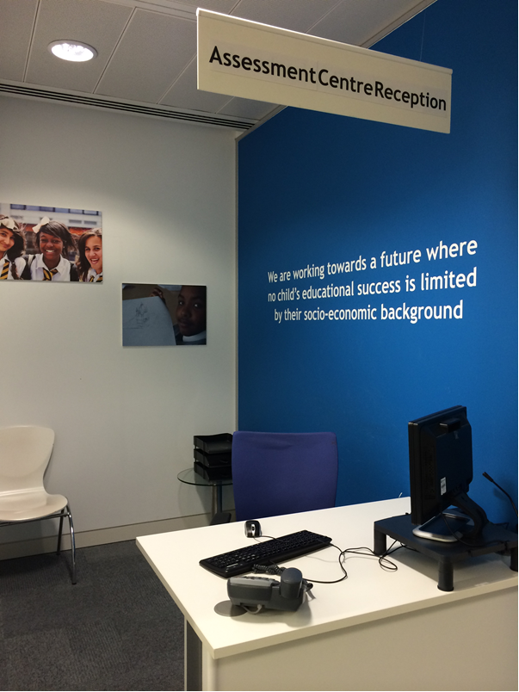
Assessment Centre Space
The Assessment Centre space was designed with candidate experience in mind - lots of features showcase our commitment to creating the optimum environment to allow candidates to perform to the best of their ability
It starts with reception, the first thing they see is our vision and images of some of our students

Slide 34
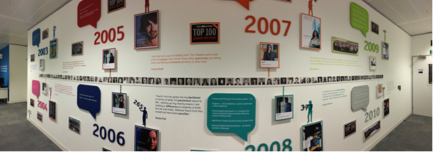
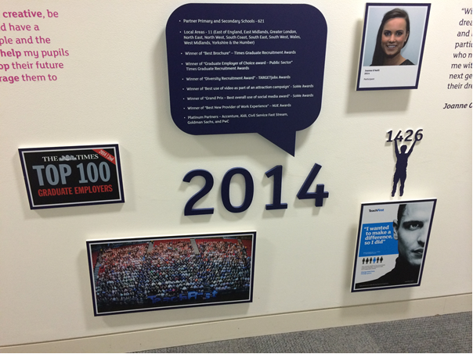
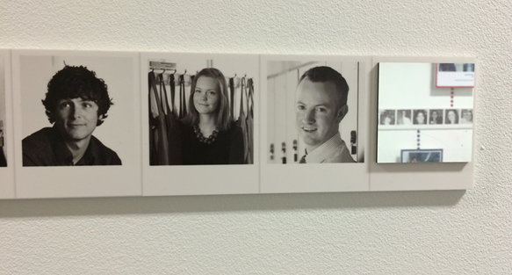

Slide 35


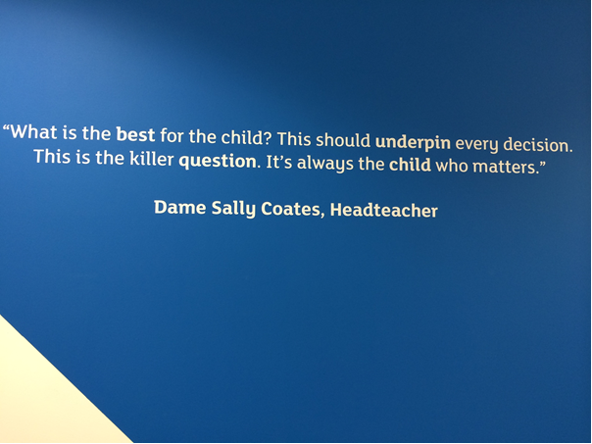
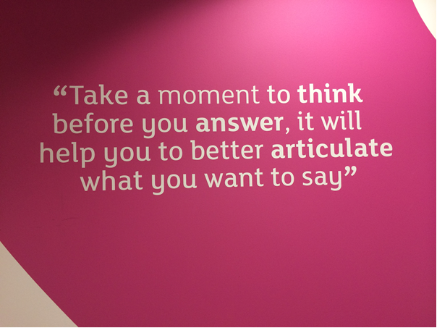

Slide 36


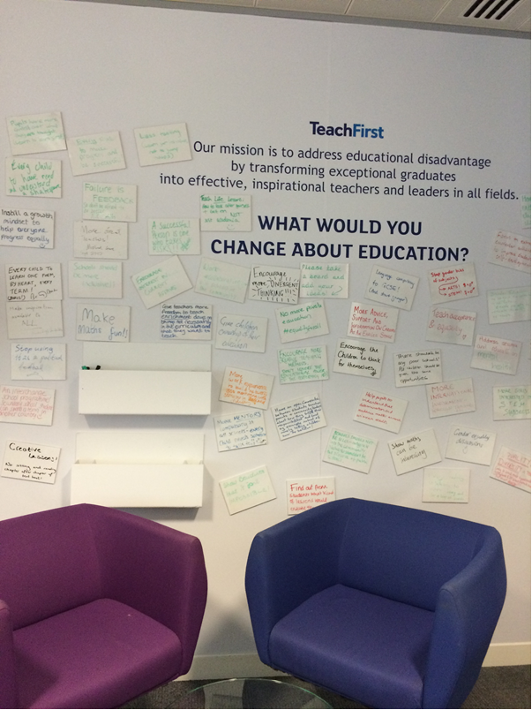

Slide 37

We Listen to our Candidates
All candidates complete feedback survey
Answers analysed & shared via regular e-blast
Content used for 1:1’s, training & continual process development

Slide 38



99.4% Felt fairly treated throughout the day
97.7% Enjoyed their Assessment experience
99.3% stated the process was clearly explained to them
99.4% Happy with the Teach First offices and waiting area
95.3% Felt the day was efficiently structured
97% felt they had enough information to help them prepare

Slide 39
Robustness of
Decision-Making
Process

Slide 40
Making Hiring Decisions
Application
All forms blind-screened by two trained screeners
Independent manager of process will re-screen third time if decision not unanimous
Assessment Centre
Wash-up meeting held consulting all Assessors and external values-based context if required
4 Assessors assess each candidate to ensure un-biased account
Enrolment
Key contacts at Teach First, and our University training providers assess candidates at each enrolment stage
Collaborative decision made on what is best for individual and pupils if all requirements not met

Slide 41
Managing Rejections
Feedback Calls
Option to re-apply
Continued support from GRO
Events
Sent information on other routes into teaching

Slide 42


Support to Ensure Effective Selecting
First week detailed feedback email & check of all notes/scores
Regular Selection checks
Quarterly updates on personal performance data
Weekly team feedback emails
Data Protection and Championing TF training
Bi-annual Refresher Training (full day)
Sporadic top-up training – desk based modules
Weekly team email update - relevant info & reading
3 days of Initial of Training
AC Re-touch days to stay connected – designed for those who do not assess regularly
Regular 1:1’s
Regular observations and benchmarking

Slide 43
Continual Reflection & Improvement
AC Analysis
REI Collaboration
We have been working with an external Assessment Design Consultancy to reflect on our current processes to support development and delivery of new options
Ongoing collaboration with our Research Evaluation & Impact team, to develop our understanding of the relationship between Selection, Assessment and Impact of participants.
STEN 10
Regular analysis reports to monitor equivalency and consistency of materials, candidate experience, performance management and progress to departmental goals.
Ongoing research into recommended best practice within selection and assessment design to ensure we continue to deliver world class graduate recruitment.
Work is being continued with them to design new exercises to trial, new content/wording for our selection stages and ensure we are in line with best practice
Working on various pieces of research to strengthen our practice further

Slide 44
Continual Reflection & Improvement
CRITERION VALIDITY
Examining the criteria by which our competencies are defined and how closely they align to the job role
2. CONTENT VALIDITY
Examining whether the content of assessment materials reflects the characteristics of the competency
3. CONSTRUCT VALIDITY
Examining whether the assessment materials measure what they intend to measure
4. RELIABILITY
Examining the quality of measurement and how consistent scores are
5. ACCURACY
- Examining the scoring criteria and how precise scores are

Slide 45

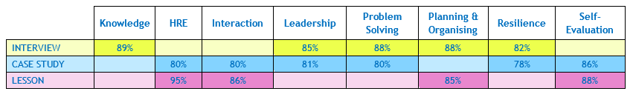
Hot Topic Analysis – “Higher quality applications” & “Selection integrity”
Possible causes for the current high pass rate:
Increased support/guidance from GROs/CAS/Peer (StudentRoom/Glassdoor)
Increased understanding in brand and profile
Strategy working (less but more focused applications) – Early engagement etc
Improvements in Selection (Screening training/conflicts)
Market factors (self-selection – less speculative applications/Teaching not as popular)
Our 5 most experienced assessors (with more than 2 seasons experience) have observed newer assessors on 186 occasions so far this season
Table showing the level of consistency for each area in the day. Sam Freedman “these values show greater consistency than those of Ofsted inspectors (evaluating lessons)” according to a recent report ☺
Notes:
Notes for James:
As of 27 April 2015 we have 1811 current participants recruited to join the 2015 cohort. We have 345 participants recruited for 2016 cohort.
There are 8 weeks remaining until Summer Institute begins; we are continuing to run assessment centres until end of May (3 weeks longer than in 13/14) so we can see the maximum number of candidates possible.
In order to deliver 1725 participants to SI, we need to make 158 new offers; this requires seeing 277 candidates at assessment centre (an additional 79 more than we currently have scheduled to attend). It will also require AC conversion rate to maintain at 57%.
We can afford to lose 190 participants to withdrawals; obviously fewer than this would be ideal, but that we are tracking at 7% worse for fresh withdrawals and 8% worse for deferred withdrawals than we had anticipated.
At this point last year we had made 640 deferred offers for the 2016 cohort; we currently have 345 deferred offers, which is going to mean we start the 2015/16 recruitment year in a more challenging position than last year and will mean we need to see a lot of candidates over the summer period to maintain lost ground.
If we can hold 57% AC conversion rate, see an additional 79 more AC candidates and make 158 new offers, as well as ensure we don’t lose more than 190 participants we should be able to deliver 1725 participants to the 2015 cohort.

Slide 46
Operational Management

Slide 47
Lessons Learnt – General
  Ongoing self evaluation of our successes/failures over the last few years have highlighted key learning’s for the future:
  Department needs to be split into pockets of experts (e.g. candidate contact)
  Staff – success hinges on having right staff in the right roles (manager & front line)
  Analysis of Data – daily/weekly analysis of operations (ROI, conversion rates, hires)
  Year round cultivation (23% of Teach First offers are turned down)
  Campus Time – Brand awareness = Applications = Hires
  Speed to Market – Application to Offer in 4 or 5 weeks
  Diversification – Fingers in many pies

Slide 48
Looking forward
  How the campaign will evolve in 2015/16:
  Customer Service Focus – Personal Candidate Management (Digital & Human)
  Intelligence led / Flexible marketing – bespoke and evolves throughout the campaign
  Emotional connection – more emotive materials being produced
  Continued campus investment – focus on 50 target universities
  Increased recruiter responsibility – on and off boarding
  Brand Managers – further investment in the programme
  Early engagement – final year is too late
  Broadening/deepening Platinum Supporters – mutually supportive on and off campus

Slide 49
The future
Despite challenges and the competitive marketplace, we recruited our largest ever intake of participants this year (1,685), growing the cohort by 18% from 2014
In 2015, Teach First provided nearly 45% of all new Science and Maths teachers in eligible
schools in England. In 2016, we will provide nearly 50%
However we aspire to grow to 2,090 teachers in 2018. To do this we need to continue building a movement on/off campus of the brightest talent inspired to deliver lasting change

Slide 50
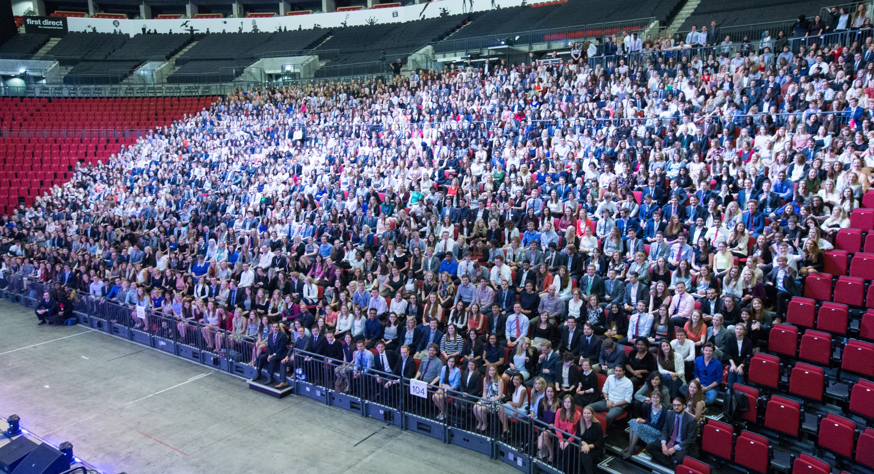

Slide 51
Questions
&
Thank You for listening

Slide 52


