Slide 1
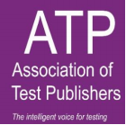
Diagnostic Feedback:
Dos and Don’ts
Michael o’leary, Darina Scully & Zita Lysaght, Dublin City University
ATP Public Sector – 6th Annual Meeting
24th & 25th September 2018, NATO HQ, Brussels

Slide 2




About the Presenters
Dr. Darina Scully
  Prometric Postdoctoral Researcher, CARPE
Dr. Zita Lysaght
  Assistant Professor, DCU Institute of Education

Slide 3
Feedback
Additional information that can:
guide failing candidates’ remedial studies and
assist institutions in evaluating the success of their programmes and identifying areas that may need to be modified (O’Leary & Scully, 2018)
Diagnostic Feedback
“Candidates who fail may profit from information about the areas in which their performance was especially weak” -AERA, APA & NCME, 2014, p.176
Notes:
-Majority of certification & licensure authorities do not provide any information beyond a basic pass/fail classification (Zenisky & Hambleton, 2012

Slide 4
Subscore Reporting
Providing candidates with multiple scores reflecting performance on different dimensions
Content areas e.g. physician licensure exam comprised of anatomy, biochemistry, pathology & pharmacology dimensions
Cognitive Processes e.g. TIMSS educational assessment comprised of knowing, applying & reasoning dimensions

Slide 5
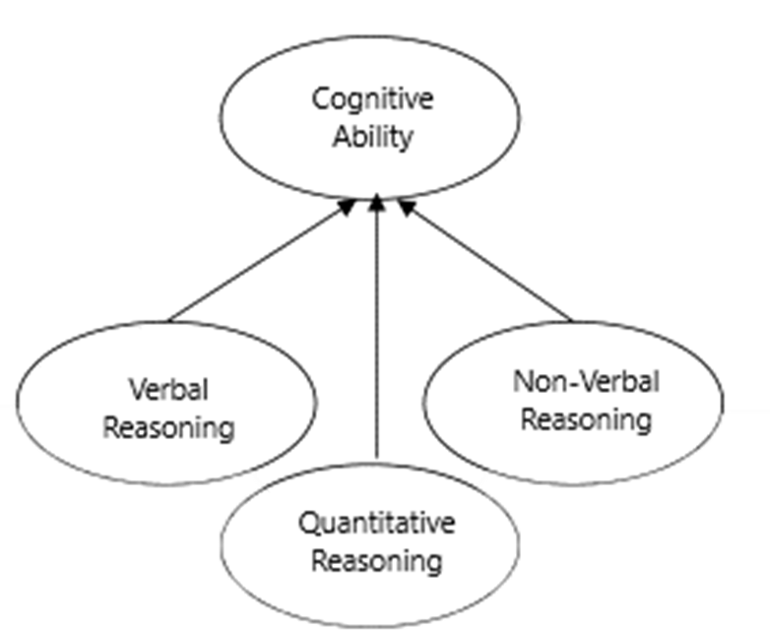
Subscore Reporting: Some Concerns
Construct should be
truly multi-dimensional
Test should be explicitly designed to reflect this multi-dimensionality
Many test publishers engage in retrofitting - tends to yield psychometrically unsound subscales -Sinharay, Puhan, Haberman (2011)

Slide 6
Subscore Reporting:
Gathering evidence of validity & reliability
Do the subscore means differ from one another?
Do item-subscore discrimination indices differ from item-total indices?
Does a factor analysis support the proposed multi-dimensionality?
Do individuals perform differently across each of the subscales?
Are the correlations among the subscores <.90?
Are there at least 20 items in each subscale?
45% educational/certification assessments report subscores that have no added value on the basis of the above criteria Sinharary, 2010
Notes:
Can only be done once the test has been administered to a large sample of candidates, as it involves the analysis of response data to ascertain the distinctiveness of the subscores
Significant diffs between subscores means, with an effect size of 0.50 provides support for validity of subscore reporting
Correlations always likely to be high, especially for content-oriented subscores – but there should be some variation
Confirmatory factor analysis can be conducted to investigate whether groups of items ‘load’ onto distinct factors
Compare each subscore to mean of subscores
Sinharay (2010) – subscales need to consist of at least 20 items “to have any hope” of being sufficiently reliable
Aggregate level? Only to those for whom it has added value? Psychometrically sound but difficult to justify

Slide 7

Scale Anchoring & Level Descriptors
Select ‘points’ along full range of possible test scores
Identify items that ‘anchor’ to one of the score ranges marked
out by these points
Identify common attributes associated with a set of items
that have anchored to a particular level
Generate meaningful descriptions of what candidates
scoring at each level know and can do (level descriptors)
Notes:
Level descriptors document a candidate’s probably capabilities/shortcomings in detail – form of diagnostic feedback

Slide 8
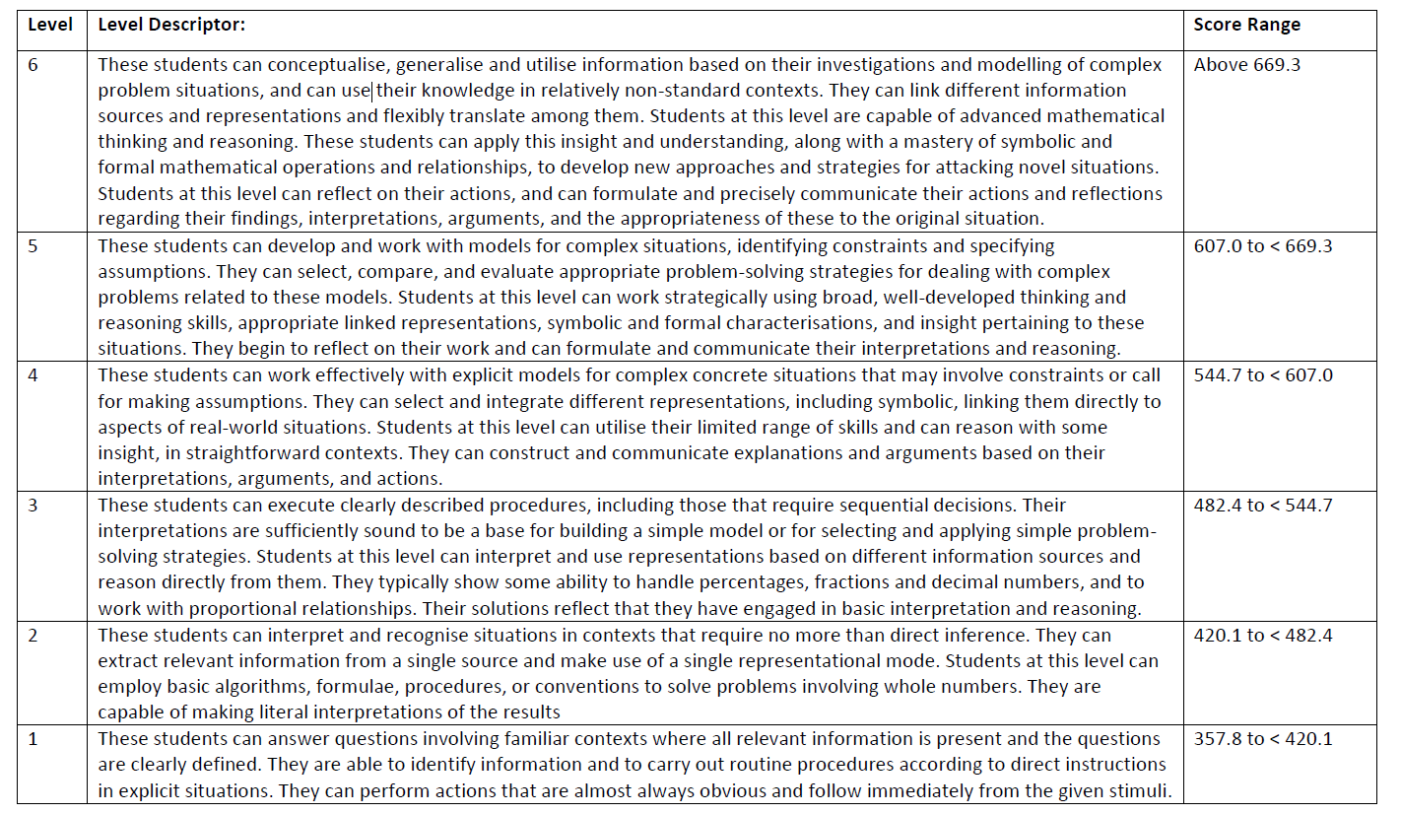
Notes:
Level Descriptors pertaining to mathematical literacy from PISA 2012

Slide 9
Scale Anchoring & Level Descriptors: Some Concerns
Can be somewhat subjective, doesn’t always “work”
Unlikely to yield meaningful level descriptors if it has not been designed for this
Need large no. items, candidates with diverse proficiency levels,
and relatively uniform precision across the entire scale
Conundrum: numerous levels desirable from a feedback point of view,
BUT more cutscores = less measurement power at each cutscore
Below basic… basic… proficient… advanced…
Top or bottom heavy? Depends on your priorities…
Notes:
Different test developers can use different criteria: e.g. “if answered correctly by at least 65% of candidates whose total score was at or above this level, and by no more than 50% of candidates whose total score lay below this level”
Anchoring criteria may not identify enough items at each level, can be difficult to identify attributes
Ultimately, if there is a desire to provide more specific feedback to failing candidates, the test should be ‘bottom heavy’, with greater numbers of items discriminating between lower levels of proficiency

Slide 10
Bottom Line?
It is possible to provide diagnostic feedback to failing candidates, using techniques such as subscore reporting or level descriptors...IF and ONLY IF:
  There is rational and empirical evidence to support multi-dimensionality
  There are sufficient numbers of items representing subscales
  There is sufficient measurement precision across the full scale of ability
Computer-adaptive testing and modularization can enhance the possibilities for provision of diagnostic feedback
Notes:
Computer adaptive testing – greater precision with fewer items
Modular tests – greater number of items representing each dimension of the original test – MoC, controversies etc.

Slide 11
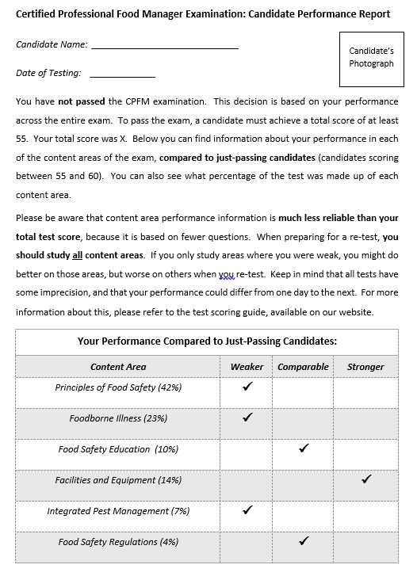
Presenting
Diagnostic Feedback
Personalized & communicated in a timely fashion
Clear and simple in terms of layout & language
Include separate interpretative guide/glossary if necessary
Display info in tabular/graphic format
Offer concrete suggestions for improvement
Be available in additional languages where appropriate
-Zenisky & Hambleton (2012)

Slide 12


Slide 13
Lev Vygotsky, Carol Dweck
& Walter Mischel
The Zone of proximal development – scaffolding
Growth vs. fixed mind-sets
Self-regulation – intrinsic vs. extrinsic motivation

Slide 14
Constructive Feedback
Goal-related/focused; descriptive and specific; actionable
Closes the gap for the candidate by offering valid responses to 3 key questions:
  Where the candidate is at currently, relative to his or her goal (baseline knowledge, skills, understanding, attitudes…)
  What s/he is aiming to achieve (immediate targets/objective en route to the ultimate goal)
  How s/he can get there (supports/scaffolding required)

Slide 15
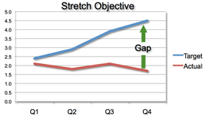
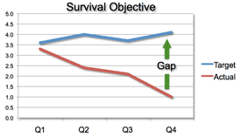
Feedback: Motivates or Demotivates

Slide 16
Feedback that Motivates and Closes the Gap
Hattie & Timperley (2007): 4 levels of feedback –
  Task-related (e.g., how to change gears – may be simply procedural)
  Process-related, typically across multiple tasks (e.g., driving safely – the same principles apply when driving cars most cars)
  Self-regulation (e.g., determining when and where to overtake another vehicle, given a range of options and opportunities – requires meta-cognition)
  Self-related (e.g., ‘Great work’ or ‘Needs more work’ – praise - vs. ‘Great work: you’ve nailed the u-turn’ – formative feedback (Hattie & Timperley, 2007)

Slide 17
Looking Ahead: Learning Progressions
Learning Progressions: “…inferences or hypotheses describing the order of definable steps, stages, or levels that students’ (AKA candidates’) understanding and skill… are likely to go through over time in response to instruction and experience as they reach the levels of understanding and skill that are the goals of instruction…. the steps or ways that understanding may plateau or reach other end points in response to variations in instruction and experience…. (Mosher & Heritage, 2017, p.1)

Slide 18
Strong/Optimistic Progressions
Hypothesis 1 posits that “… the number of likely paths is small; the steps along the way can be fairly clearly distinguished from each other; and they represent more or less complex, configurations of understanding and related skills that are stable for some discernible time, though in the period between steps there may be multiple sub-steps, confusion, and regression of various kinds, as a candidate’s thinking undergoes reorganisation into a new configuration. Candidates may at any time along the way show a reversion to the characteristic thinking and cognitive practices of earlier stages in the face of stress, complexity, or other challenges.” (2017, p. 2)

Slide 19
Weak/Agnostic Progressions
Hypothesis 2 “…is agnostic about the number of likely progressions and how well defined their levels may be, but holds that some teaching-learning paths will be more likely than others to reach desired, or better, outcomes. Those paths can be identified through repeated cycles of design, development, and testing, paying close attention to each candidates’ learning and to what pedagogical responses to them are effective. If such attention is in fact, paid, and the results are captured and aggregated, in the long run that should increase our knowledge of which paths work better for whom. Over time those results also might, or might not, provide evidence for the stronger progressions hypothesis.” (2017, p. 2)

Slide 20

Real World Applications
http://www.wdtsea.org/helpful-websites/
https://www.transport.tas.gov.au/__data/assets/pdf_file/0007/146734/312077_LTS_Driving_Assessment_May_2016b.pdf

Slide 21
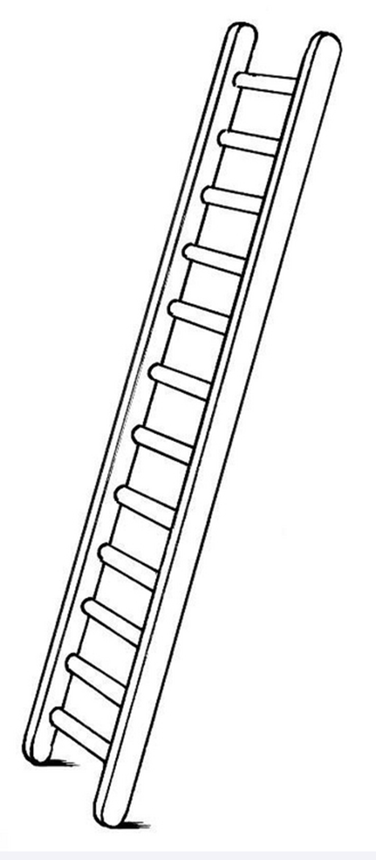
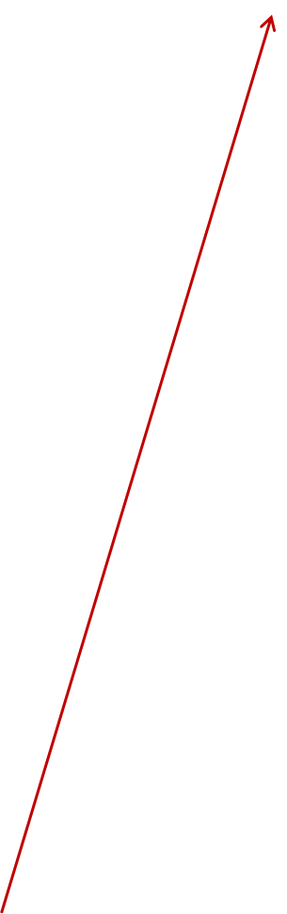
Rasch Modelling for
Precise Diagnostic Feedback
High level, hard steps
Every variable stretches across a continuum of simple-to-complex tasks, levels of knowledge, affective characteristics, or cognitive abilities
Test developer constructs a deliberate hierarchical arrangement of tasks like a ladder, that a person is located along and who can then be expected to advance along that continuum (or up the ladder).
Low level, easy steps

Slide 22
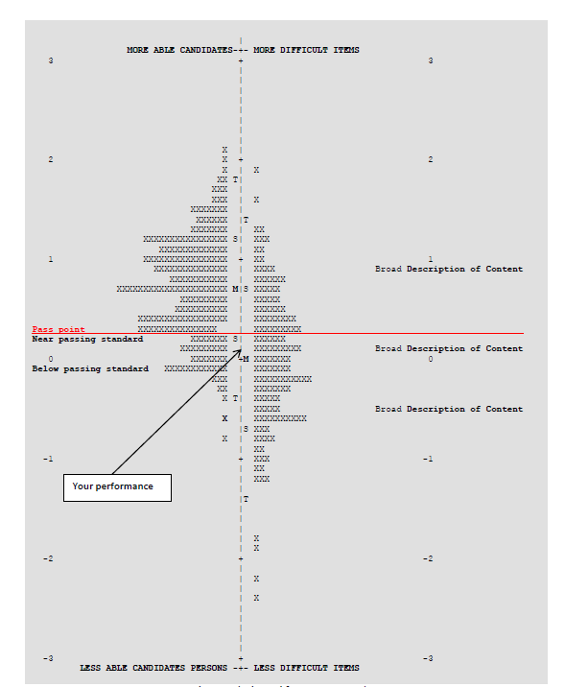
Rasch Modelling for
Precise Diagnostic Feedback
A priori hypothesized structure of construct
Ideally: candidates & items placed along the same scale
(easy items/lower ability candidates hard items/higher ability candidates)
Usually requires multiple iterations
“Fit” statistics indicate how well the data fits the model and thus how much confidence you can have in using this approach

Slide 23
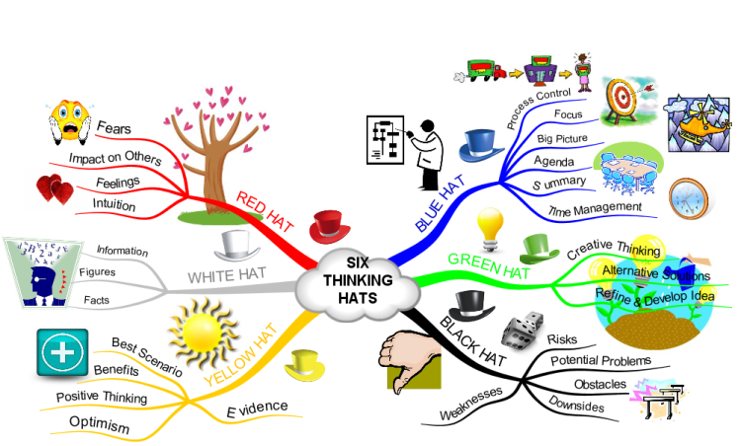
Over to You…

Slide 24
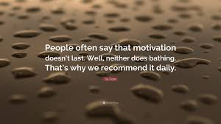
Thank you for your time, attention and engagement.

