Slide 1
It’s All About the Data, Folks!
IATP – November 9, 2016

Slide 2



Slide 3
Test Development Process
Define domain of knowledge and skills
Build test specifications
Set cut score(s)
Write, review, revise items
Report and analyze test results
Run psychometric analysis
Field test items

Slide 4
Test Purpose
Test purpose defines the who we test and why we test the who
  Drives all test development decisions
    Test content
    Test design
    Item development
    Field test strategy
    Standards setting
Test purpose also drives how we use the data
  How the data is reported
  How test results are used for key decisions

Slide 5
Test Purpose and Test Use
Test Purpose | Test Content | Test Use
 |  | Appropriate |  | Inappropriate
 |  | Primary | Secondary
Measure individual student’s mastery of mathematics knowledge and skills taught in a specific textbook chapter. | The test must only assess the content taught in that chapter. | Instructors use test results to gauge how well each student has mastered the content and identify areas in which s/he needs remedial help. | Administrators use aggregated results to gauge if there are persistent areas of weakness for a cohort of students and recommend alternative instructional approaches at the programmatic level. | Use student results to make judgments about the instructor's knowledge and competencies.

Slide 6
Formative Assessments
Also known as, assessments FOR learning
Evaluate periodic learning
  Tests administered every 6-8 weeks
  Tests assesses
    content taught within the 6-8 week window OR
    cumulative content
    consistent with pace and sequence of classroom instruction
Provides a snapshot of what students have learned to guide decisions pertaining to remediation or subsequent instruction
Low stakes tests with no penalties for students who perform poorly or teachers who instruct those students
Test questions are available to teachers and key stakeholders after administration

Slide 7
Mathematics Formative Assessment
Test Purpose | Test Content | Test Use
 |  | Appropriate |  | Inappropriate
 |  | Primary | Secondary
Provide teachers with actionable data about what their students have successfully learned during mathematics instruction over a 6- week period. | The test assesses mathematics content taught during the 6 week period. | Teachers use aggregated class level results to evaluate students’ performance and assess areas of strengths and weaknesses. | Teachers and principals use aggregated results for entire grade level to guide programmatic changes that may need to be made to mathematics instruction. | Teachers and students are penalized for poor performance.

Slide 8
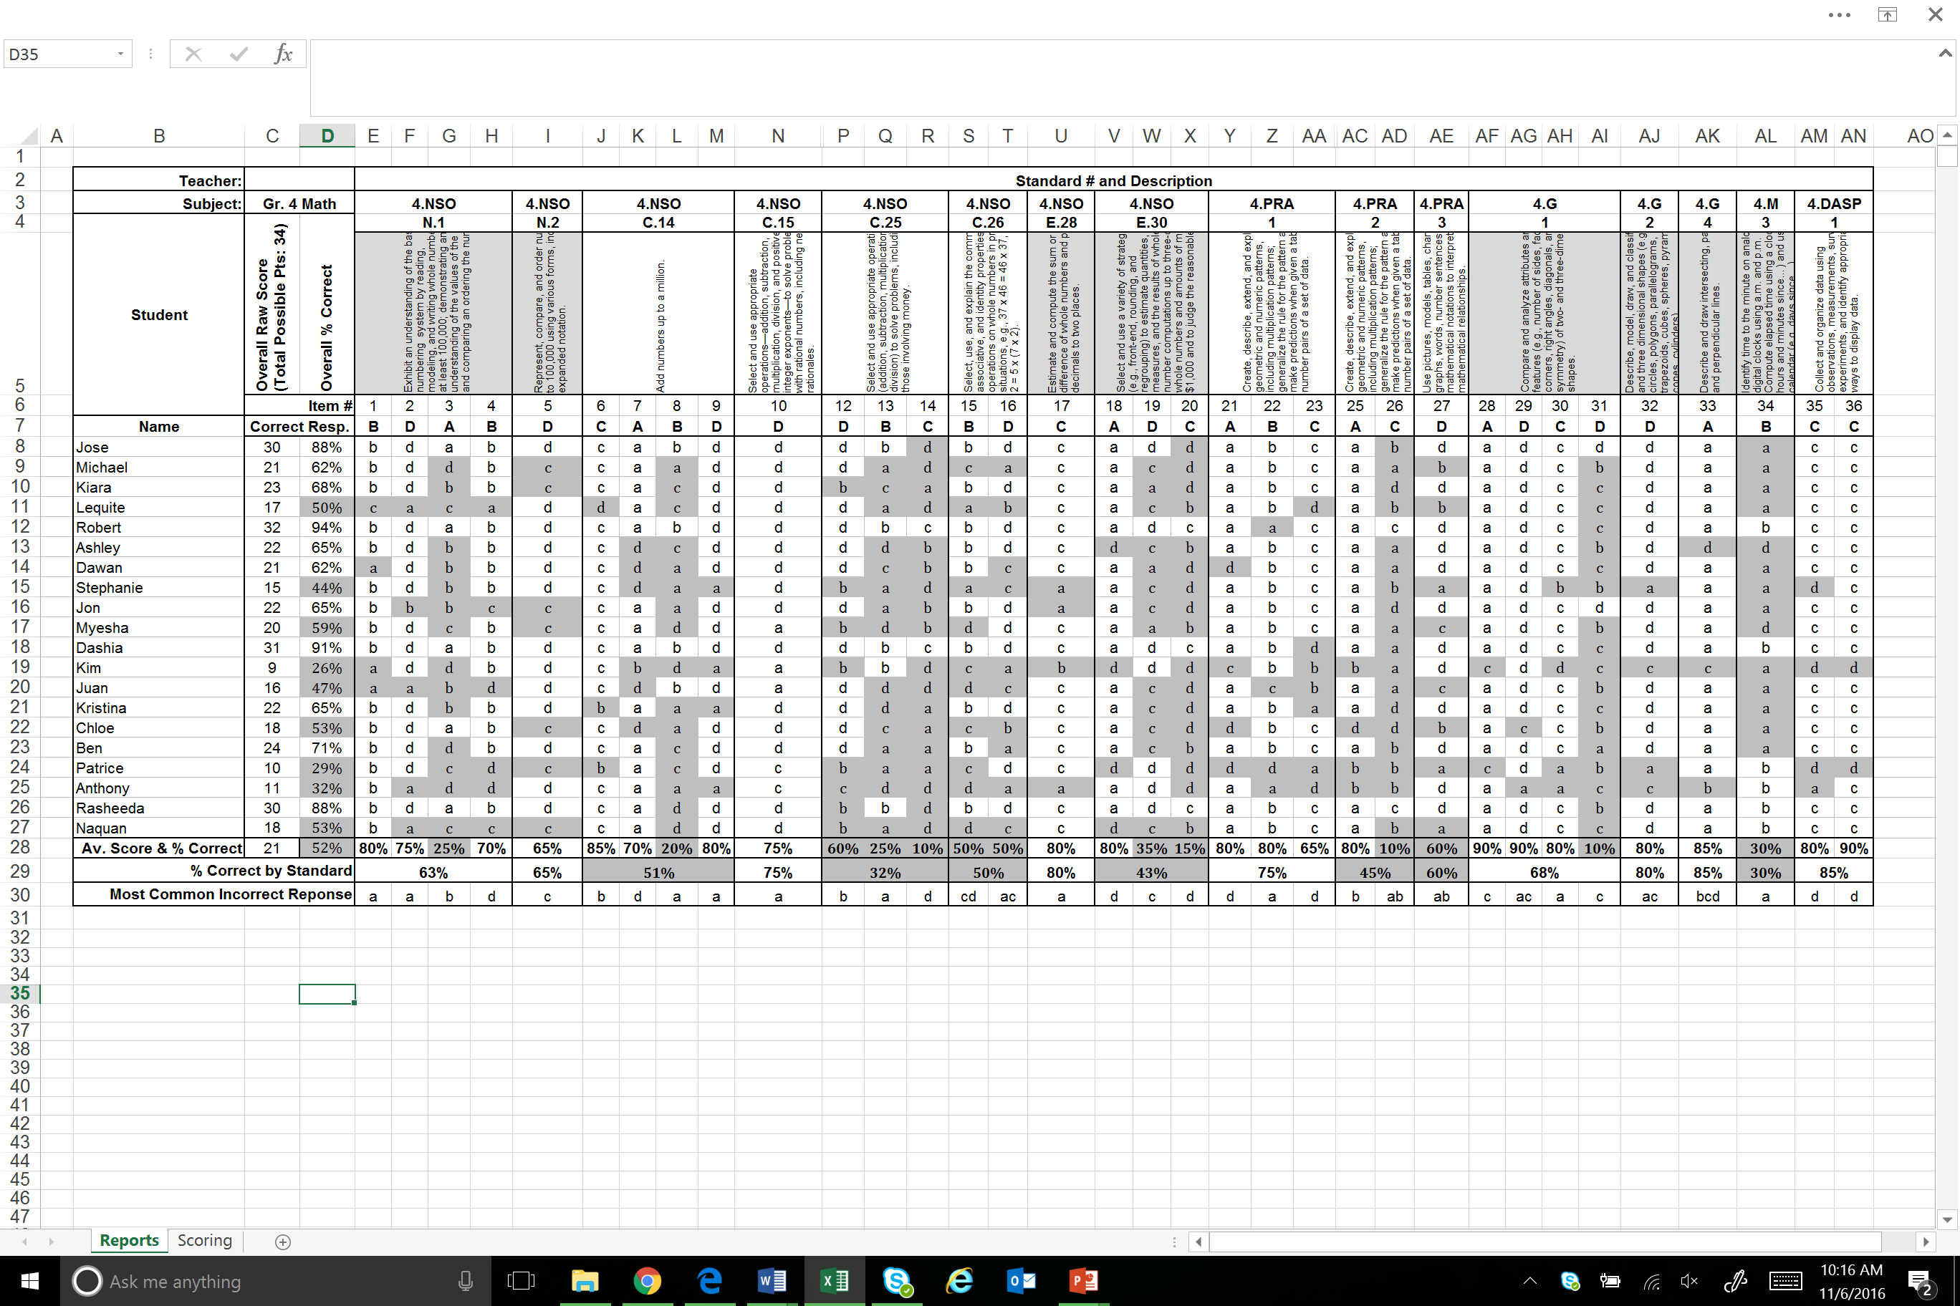
Formative Assessments: Classroom Level Report

Slide 9
Formative Assessments: Classroom Level Report

Slide 10
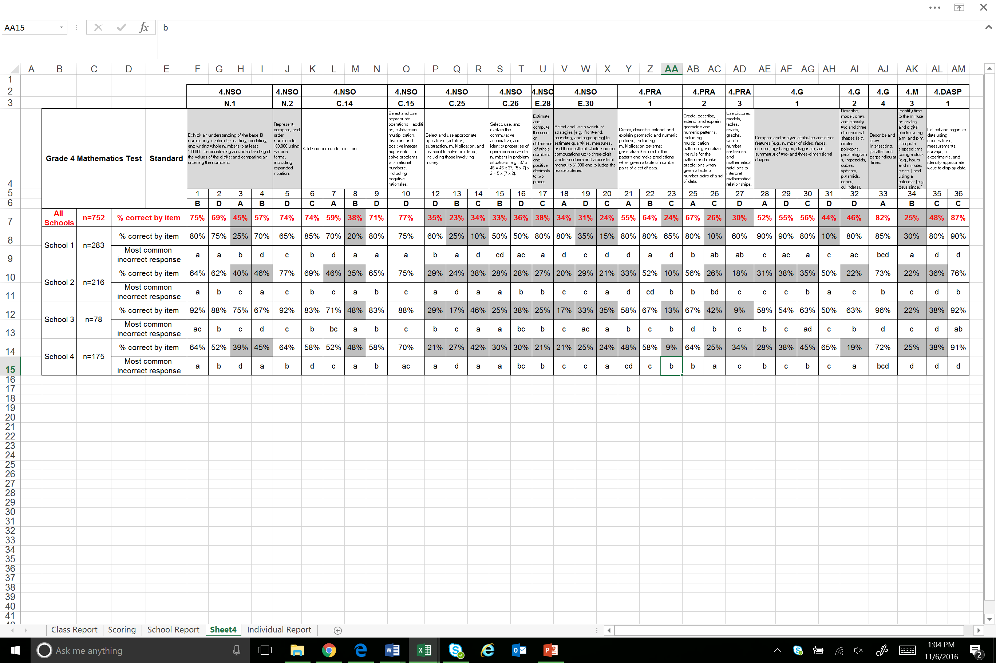
Formative Assessments: School Comparison Report

Slide 11
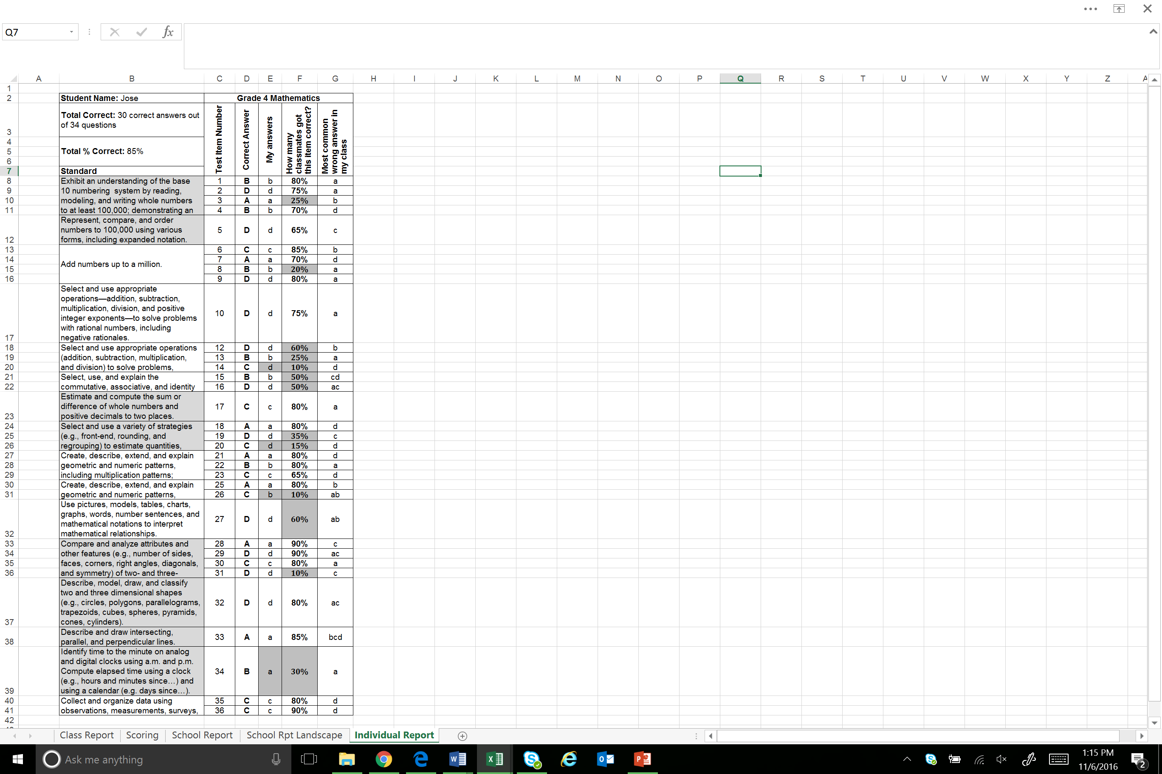
Formative Assessments: Student Report

Slide 12
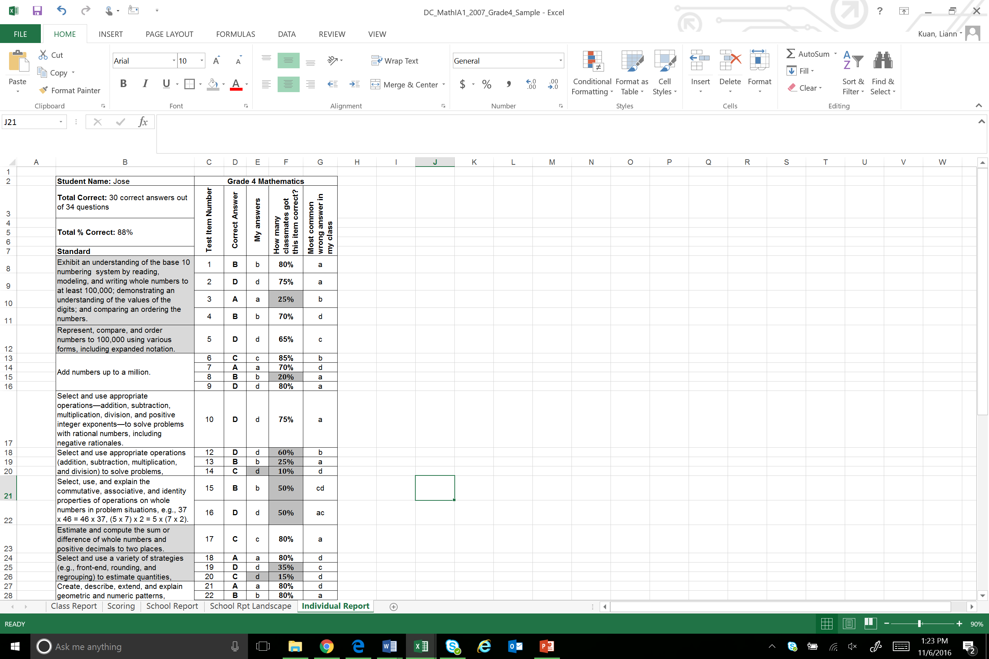
Formative Assessments: Student Report

Slide 13
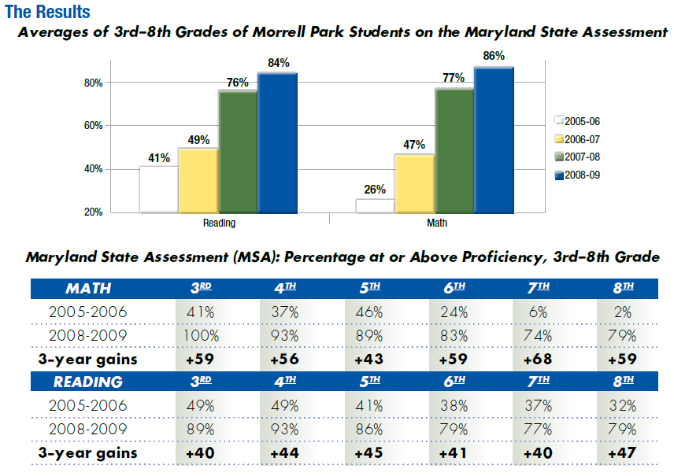
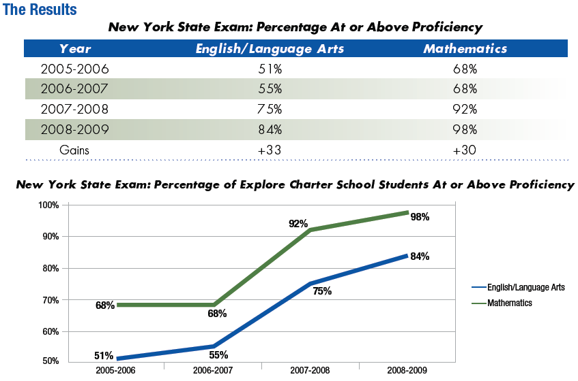
Impact of Data-Driven Culture on Student Achievement
Graphs below show student performance on high-stakes end-of-year statewide assessments for two different schools in two states
Educators from both schools attribute student success to their formative assessment programs:
  Teachers able to analyze the common assessment data together, establish common goals and plans
  Teachers took full ownership of results, looked closely at what they could improve

Slide 14
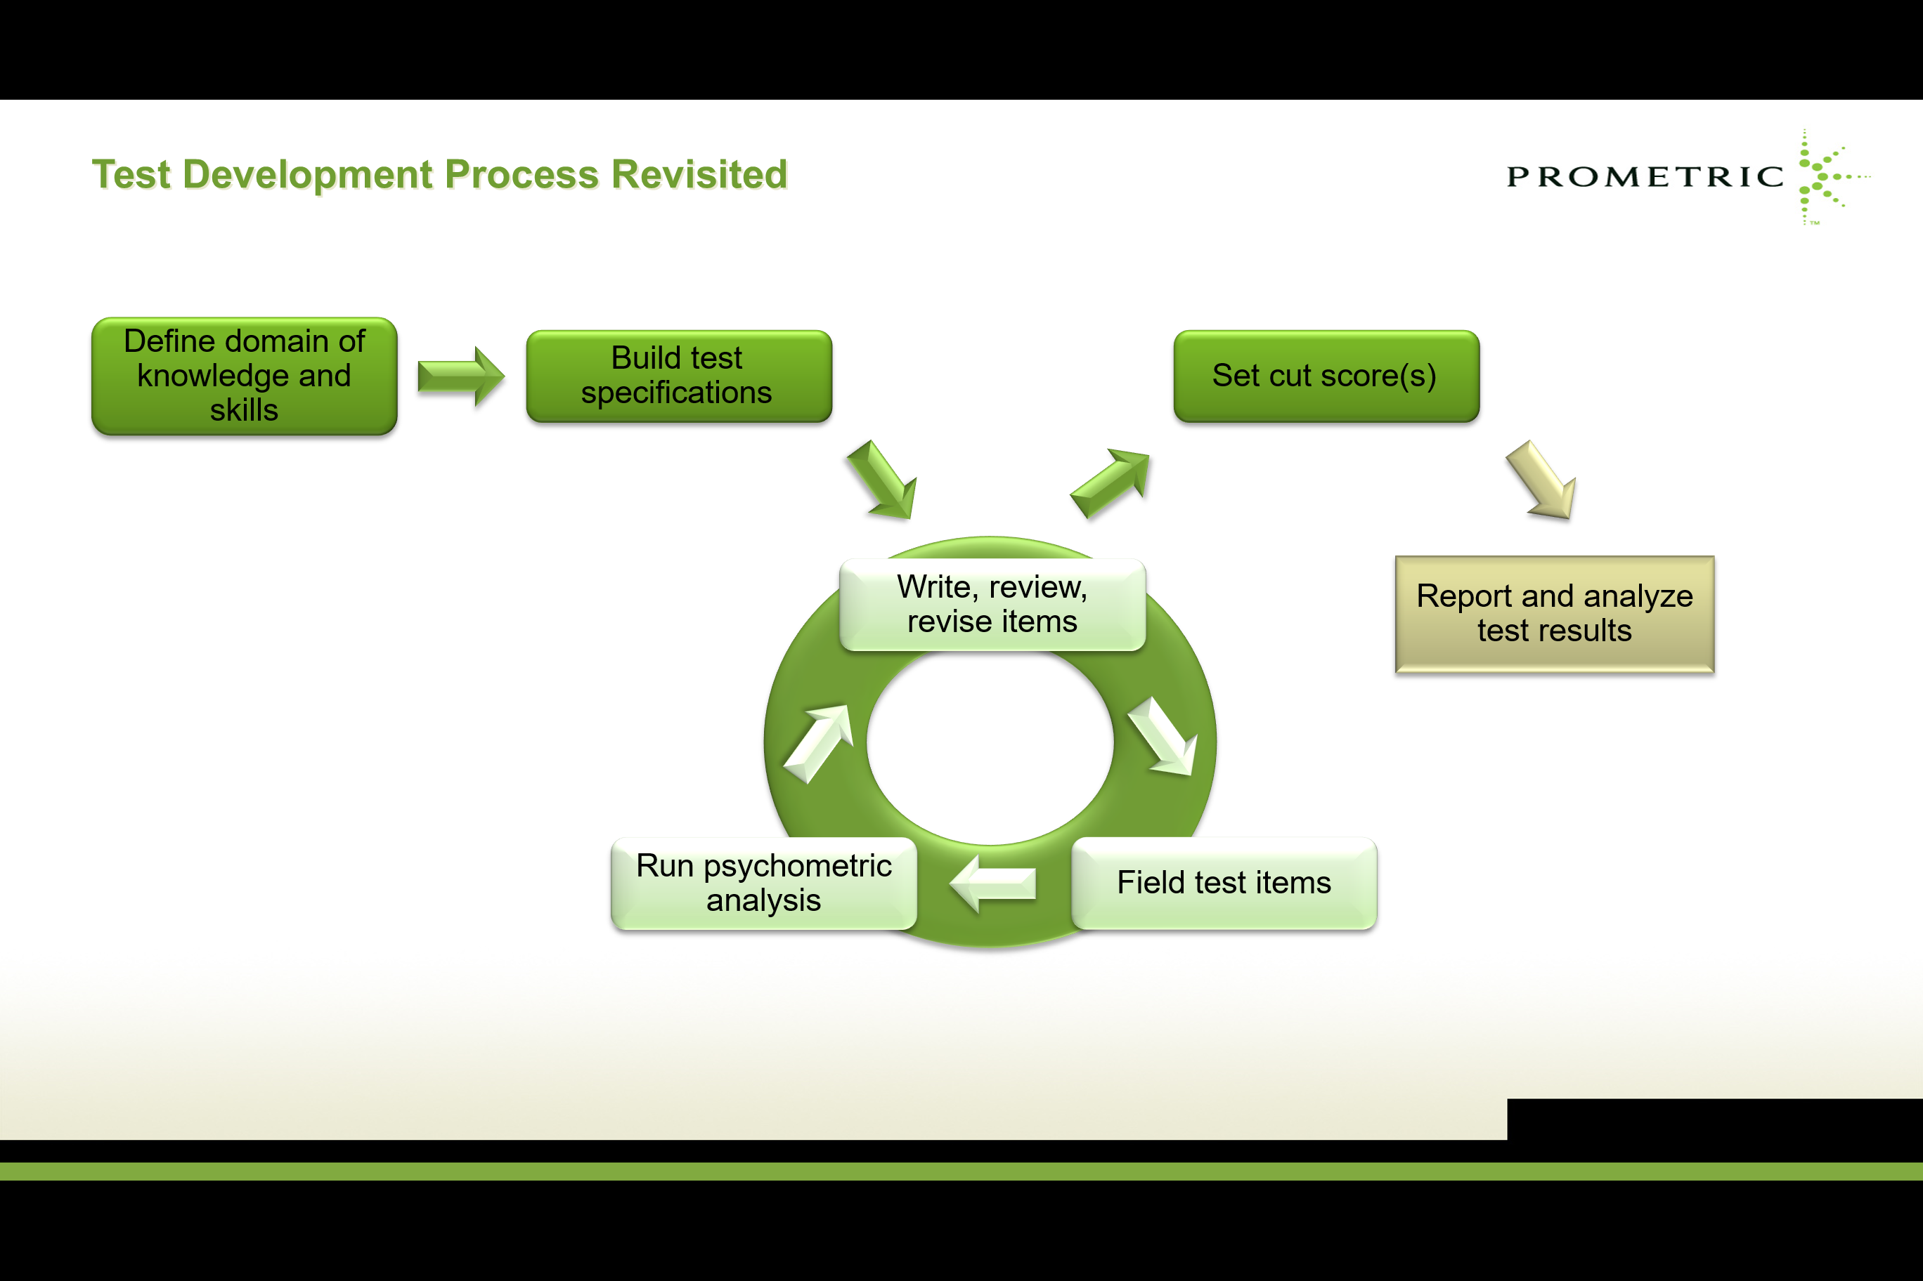
Key Takeaways
Meaningful analyses can only be completed with valid and reliable test data
Valid and reliable test data can only come from proper test development efforts

Slide 15
Thank you for joining me this morning!
Please join me this afternoon for a Date with Data – an interactive session where we will review a class level report alongside actual items

