Slide 1
Getting HR
Fit-for-Purpose
The Storm Is Coming

Slide 2
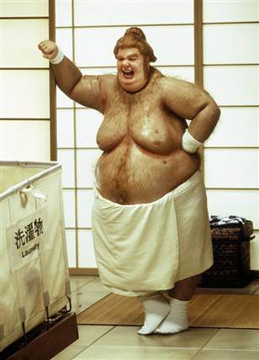
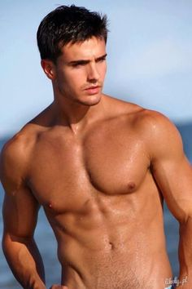

Slide 3
What is the ‘Purpose’?
The parable of JFK and the Janitor at NASA.
What is the purpose – or business – of your organizations or departments?
How many of your HR staff really understand this?
Do your staff have a context of why they turn up for work?
In the UNFPA context it is delivering a world where every pregnancy is wanted, every childbirth is safe, and every young persons potential is fulfilled.

Slide 4
What’s Driving the Change?
The S-G’s call for the UN System to be Fit-for-Purpose
Member States demanding new modes of engagement aligned to business strategy
Strong emphasis on demonstrating results
The SDGs – now a universal set of goals applicable to all countries rather than North dictating to the South.
The relative decline (influence) of the traditional donor.
Social media and the ground swell of change from the bottom up
1.8 billion young people.

Slide 5
So … Are We Fit-for-Purpose?
To what extent have we [really] moved along the continuum from Personnel Administration to Strategic Human Resources Management?
Are our HR structures aligned with our new business realities?
Are our activities aligned with the strategic directions of our organizations?
Are we looking at things holistically, or still business unit by business unit?
Are we still performing ‘legacy activities’ without taking the difficult decisions?
Do we need to exist at all?

Slide 6
What Are We Currently Doing?
Recruitment
Policy
Legal
Performance Management
Career Development
Staff Benefits and Entitlements
Compensation
Insurance and Medical
Reporting and Compliance
Career Transition
Workforce Analytics
Branding and Sourcing
Employee Engagement
Change Consulting
Business Partners
Strategic Legal
Risk Management

Slide 7
Do We Have the Competencies?
Strategic Positioner?
Credible Activist?
Capability Builder?
Change Champion?
HR Innovator and Integrator?
Technology Proponent?
Dave Ulrich, Jon Younger, Wayne Brockbank, Mike Ulrich., HR from the Outside In: Six Competencies for the Future of Human Resources, 2012

Slide 8
FFP and Different Disciplines
FFP and Recruitment and On-boarding
FFP and Performance Management
FFP and Career Development and Career Transition
FFP and Change Management
FFP and Foundational Service Delivery
FFP and the Contractual Landscape
FFP and the Administration of Justice

Slide 9
What Do We Need to Get Fit?
We need to know our ‘goal weight’ or what we want to look like
We need a comprehensive mapping of what we are doing, why we are doing it, where we are doing it, who is doing it for us and …… if we should be doing it at all.
We need to know how we are going to get there and build a governance structure to ensure we have Leadership and Organizational buy in.
We need champions, we need disciples and we need followers.
We need to communicate, communicate and continue to communicate
We need adequate resources, and if not we need to be resourceful.
We need resilience, persistence, persuasion and patience.

Slide 10
Reflections, Takeaways and Questions?
Thank you!

